Slide 1

DEPARTMENT OF COMPUTER SCIENCE AND ENGINEERING
UNIVERSITY COLLEGE OF ENGINEERING
ADIKAVI NANNAYA UNIVERSITY
RAJAMAHENDRAVARAM
Amazon Echo Reviews Sentiment Analysis Using NLP
Under the esteemed guidance of
Dr. B. Kezia Rani
Head of the Department
Department of CSE
Submitted by
J.DHEERAJ
IV B.Tech CSE
Reg No: 208297601021

Slide 2
CONTENTS
ABSTRACT
INTRODUCTION
EXISTING SYSTEM AND DRAWBACKS
PROPOSED SYSTEM
FUNCTIONAL REQUIREMENTS
NON-FUNCTIONAL REQUIREMENTS
SOFTWARE REQUIREMENTS
HARDWARE REQUIREMENTS
ARCHITECTURE
UML DIAGRAMS
IMPLEMENTATION
OUTPUT SCREENS
CONCLUSION
FUTURE ENHANCEMENT
REFERENCES

Slide 3
ABSTRACT
The increasing volume of product reviews across online platforms presents a challenge for sellers to analyze customer sentiments. Examining thousands of customer reviews is time-consuming and tedious. This project proposes a sentiment analysis system utilizing machine learning (ML) and natural language processing (NLP) to address the challenge that benefits both the company and the customer. The system aims to extract valuable insights from large sets of product reviews, aiding sellers in enhancing product features and informing potential customers about product pros and cons. This project enhances the present scenario by offering NLP techniques to train ML model using XG Boost and Random Forest models, and advanced data visualizations providing insights to customers. Effective customer feedback analysis is crucial for any company, as it serves as a valuable resource for enhancing business opportunities and overall improvement.
Key-words: XG Boost, Random Forest, Sentiment Analysis, NLP

Slide 4
INTRODUCTION
The project includes several key components, such as data preprocessing, model application, and performance analysis. NLP techniques are used to preprocess the text data. This involves tasks such as tokenization, lowercasing, removing stop words, stemming, and handling special characters. The preprocessed data is split into training and testing sets. Machine learning models, such as XGBoost and Random forest classifiers, are applied to the preprocessed and split data to perform sentiment analysis. The performance of the applied models is evaluated using metrics such as accuracy, precision, recall, and F1 score to assess their effectiveness in predicting sentiment.
The project also involves the development of a user interface, potentially using a web-based application built with Flask, to allow users to interact with the sentiment analysis system. The interface supports functionalities such as selecting the dataset, providing text input for analysis, and displaying the sentiment analysis results.

Slide 5
EXISTING SYSTEM
The existing system is a rule-based system that uses pre-defined rules to classify the sentiment of the reviews. This approach involves defining a set of rules based on keywords or phrases that indicate the sentiment. However, this approach may not be effective in capturing the nuances of language and may not be adaptable these days.
DRAWBACKS:
Nuance and Context issues
Low Scalability and High Maintenance
Limited Adaptability

Slide 6
PROPOSED SYSTEM
By adopting machine learning and NLP-based approaches, the project aimed to overcome the limitations of the rule-based approach, allowing for more adaptive, data-driven, and context-aware sentiment analysis of the Amazon Alexa reviews. The interface supports functionalities such as selecting the dataset, providing text input for analysis, and displaying the sentiment analysis results.
ADVANTAGES:
Better Nuance and Context
Efficient for larger data sets
Subjective

Slide 7
FUNCTIONAL REQUIREMENTS
1) Prediction: The system should be capable of making predictions on new data using the trained model.
2) Graph generation: Providing visuals or reports summarizing sentiment trends and patterns for easy interpretation.
3) Data acquisition: The system should be able to get data through a user interface so that users to interact with the system and input their own sentences for sentiment analysis.
4) Evaluation Metrics: Standard evaluation metrics such as precision, recall, and F1 score to accurately assess the performance of the sentiment analysis model.

Slide 8
NON-FUNCTIONAL REQUIREMENTS
1) Usability: The user interface must be intuitive, with clear navigation and easy-to-understand features to ensure user adoption and satisfaction.
2) Reliability: The code should handle potential errors gracefully, providing informative error messages.
3) Cross-Platform Compatibility: The code should be portable across different operating systems like Windows, macOS, and Linux without significant modifications.
4) Ease of Understanding: Code and comments should be in a way that is easy to understand for both novice and experienced users.

Slide 9
SOFTWARE REQUIREMENTS
1)Programming Language: Python-3
2)Integrated Development Environment (IDE): Jupyter Notebook, Pycharm.
3)Libraries and Packages: pandas for data manipulation
wordcloud for creating word clouds
scikit-learn for machine learning tools
matplotlib and seaborn for data visualization
JupyterThemes for distinguishing between graphs
nltk for natural language processing tasks
HARDWARE REQUIREMENTS
1)RAM: 4GB
2)Storage: 32 GB
3)Processor: Intel i5

Slide 10

SYSTEM ARCHITECTURE
Amazon review dataset
Handling missing values
Input data
Preprocessing
Drop unwanted columns
Stop words, stem words
NLP techniques
Remove punctuations
Feature Extraction
Count vectorization
Data Splitting
XG Boost and Random Forest
Accuracy
Output
Test
Predictions
Train
Visualizations

Slide 11
UML DIAGRAMS

Slide 12
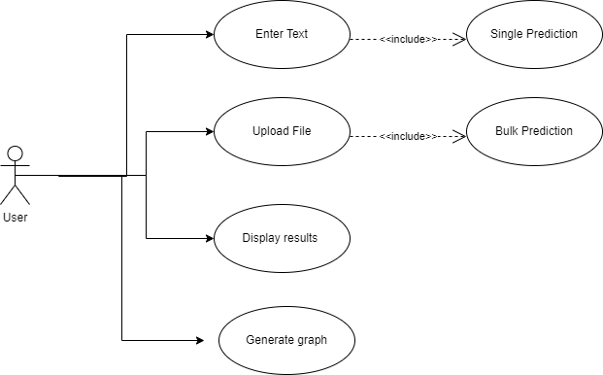
USE-CASE DIAGRAM
Enter Text:A user can input a piece of text directly into
the provided interface.
Upload File: A user can upload a CSV file containing
multiple reviews.
Display Results: After entering text or uploading a file,
the user can view the sentiment analysis results.
Generate Graph: Users get a visual representation of
sentiment distribution or trends.

Slide 13
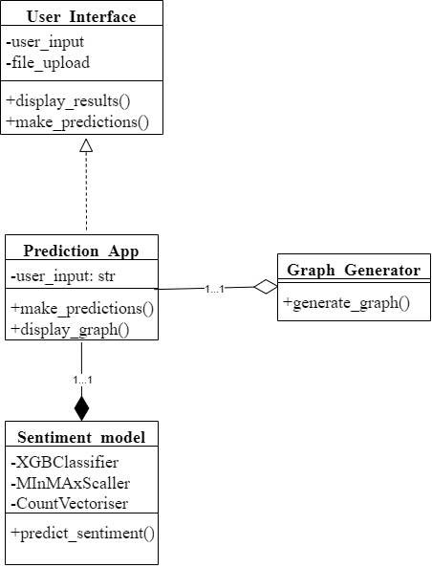
CLASS DIAGRAM
User Interface:
Represents the visual elements that users interact with.
Attributes: user_input , file_upload
Methods: display_results(), make_predictions()
Prediction App:
Coordinates the overall prediction process.
Methods: make_predictions(), display_graph()
Sentiment Model:
Encapsulates the machine learning model for sentiment analysis.
Attributes: XGBClassifier , MinMaxScaler (for data normalization),
CountVectorizer (for text feature extraction)
Methods: predict_sentiment()
Graph Generator:
Creates visual representations of the predictions.
Methods: generate_graph()

Slide 14
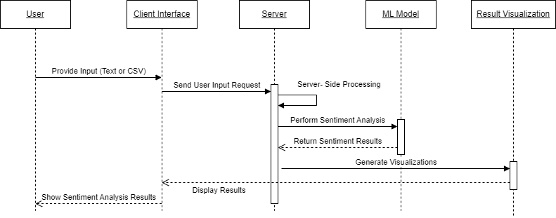
SEQUENCE DIAGRAM

Slide 15
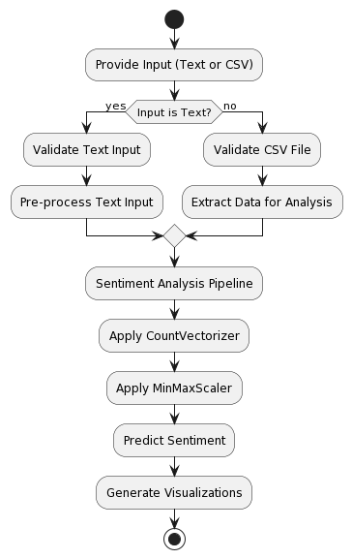
ACTIVITY DIAGRAM
1. User Input Processing: The user provides text input or a CSV file with sentences for sentiment analysis.
2. Input Validation and Pre-processing: The system validates the input and performs pre-processing steps such as removing special characters and converting text to lowercase.
3. Sentiment Analysis: The pre-processed input is transformed into a machine-learning model-friendly format and fed to a trained machine-learning model to predict the sentiment of each sentence.
4. Result Visualization and Output: The system generates visualizations and displays the predicted sentiment for each input sentence or generates a downloadable CSV file containing the predictions.

Slide 16
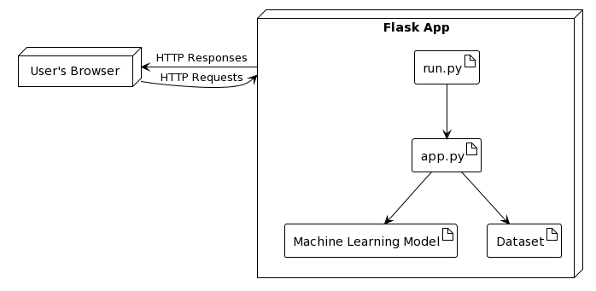
DEPLOYMENT DIAGRAM
NODES:
Browser: Represents the user's web browser.
Server: Represents the local machine where the Flask app is deployed.
Flask App: Represents the Flask application itself, containing its components.
ARTIFACTS:
app.py: The main Flask application script.
run.py: The script used to start the Flask development server.
Machine Learning Model: The trained machine learning model used by the app.
Dataset: The dataset used to train the machine learning model.

Slide 17
IMPLEMENTATION PHASE

Slide 18
MODULES
Data Selection
Data Preprocessing
NLP techniques
Data Splitting
Feature Scaling
Classification
Result Generation

Slide 19
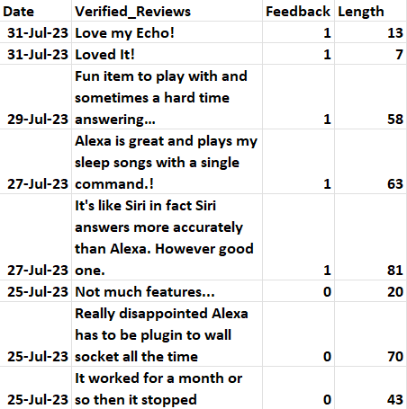
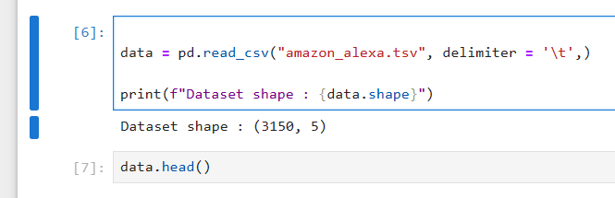
ABOUT DATA-SET
The dataset for this project is sourced from Amazon’s official Alexa skill store. The dataset encompasses the 5th generation of Echo Dot reviews, ranging from 2023, It contains a total of 3150 customer reviews. The dataset is in .tsv format and can be processed using the pandas library.
Useful Attributes: Verified_Reviews, Feedback, Length.
Useless Attributes: Date, Variation.
Data Selection Code and Output:

Slide 20
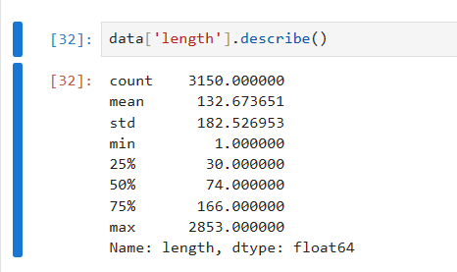
Statistical Measures:
count: Total number of non-null values in the column. In this case, there are 3150 non-null values.
mean: The average value of the column. The average length is approximately 132.67.
std: The standard deviation, which measures the dispersion or spread of the values. It's approximately 182.53, indicating a
wide variation in the lengths.
min: The minimum value in the column. The shortest length is 1.
25%: The value below which 25% of the data falls. Also known as the first quartile or Q1. In this case, 25% of the data have
a length of 30 or less.
50%: The median of the data, also known as the second quartile or Q2. Half of the data have a length of 74 or less.
75%: The value below which 75% of the data falls. Also known as the third quartile or Q3. In this case, 75% of the data have
a length of 166 or less.
max: The maximum value in the column. The longest length is 2853.

Slide 21
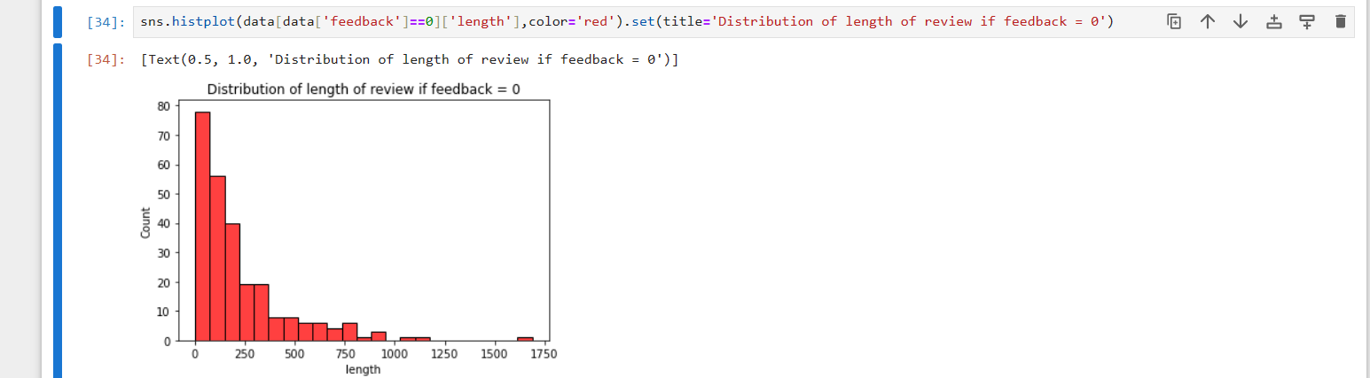
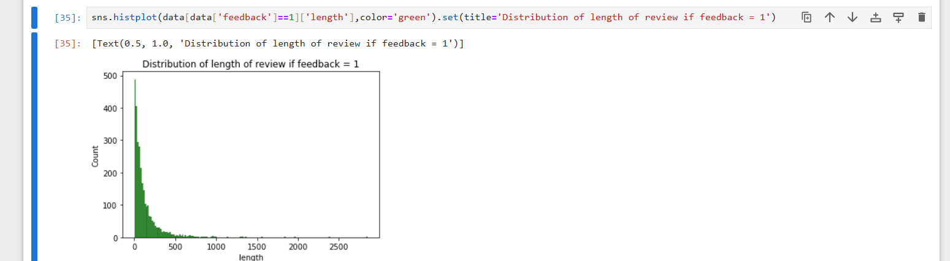

Slide 22
Data Preprocessing and NLP Techniques:
1. Stopword Removal: This involves removing common words that do not carry much meaning, such as "the", "and", "a", etc. In this project, the `nltk.corpus.stopwords` module is used to remove stopwords from the text data.
2
2. Stemming: This involves reducing words to their root form, such as "running" to "run".
In this project, the `nltk.stem.PorterStemmer` module is used to stem the words in the text data.
3. Text Cleaning: This involves removing any unwanted characters, symbols, or punctuation from the text data. In this project, the `re.sub()` method is used to replace any non-alphabetic characters with a space.
4. Feature Scaling: This involves scaling the numerical features in the data to a common scale to avoid bias towards certain features. In this project,`sklearn.preprocessing.MinMaxScaler` module is used to scale the numerical features in the data.

Slide 23
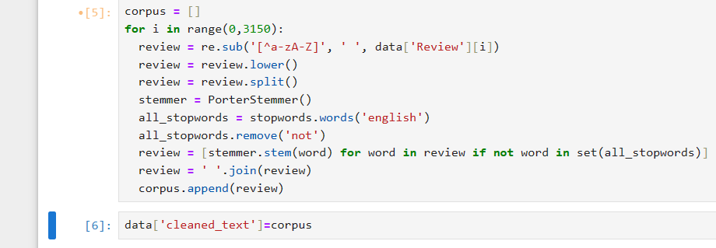
Data Preprocessing and NLP techniques code:

Slide 24
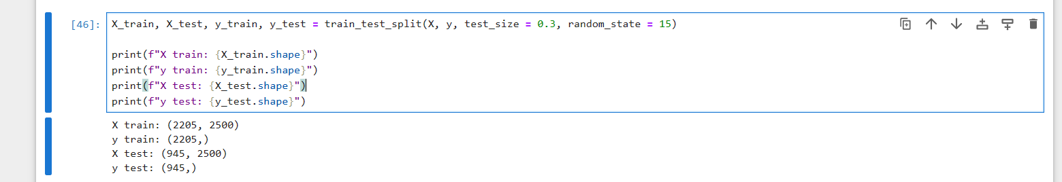
Data Splitting and Code:
Splitting the Data: The dataset is split into training and testing sets using the train_test_split function, where 70% of the data is used for training and 30% of the data is used for testing.

Slide 25
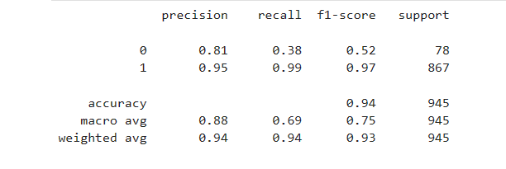
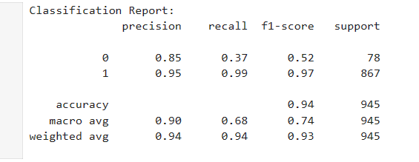
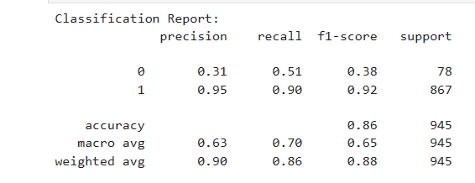
Classification Reports:
XG Boost Classifier
Random Forest Classifier
Decision Tree Classifier

Slide 26
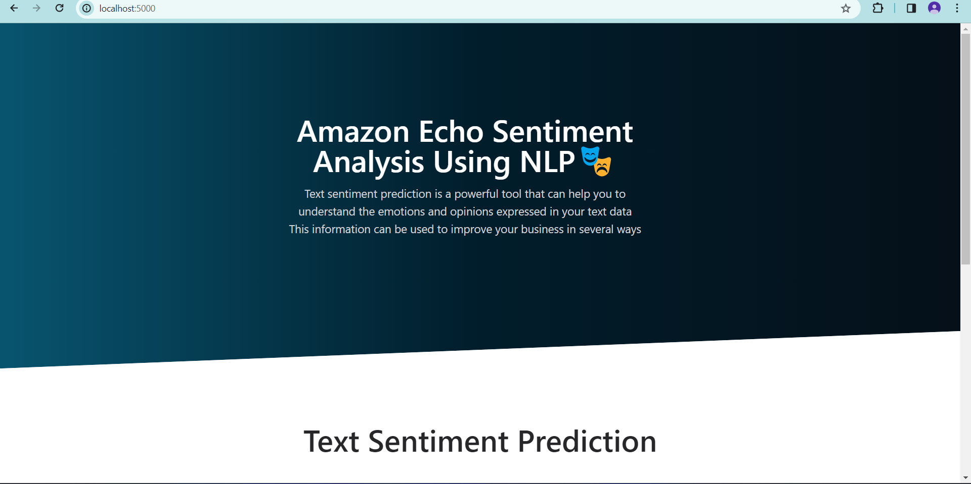
OUTPUT SCREENS

Slide 27
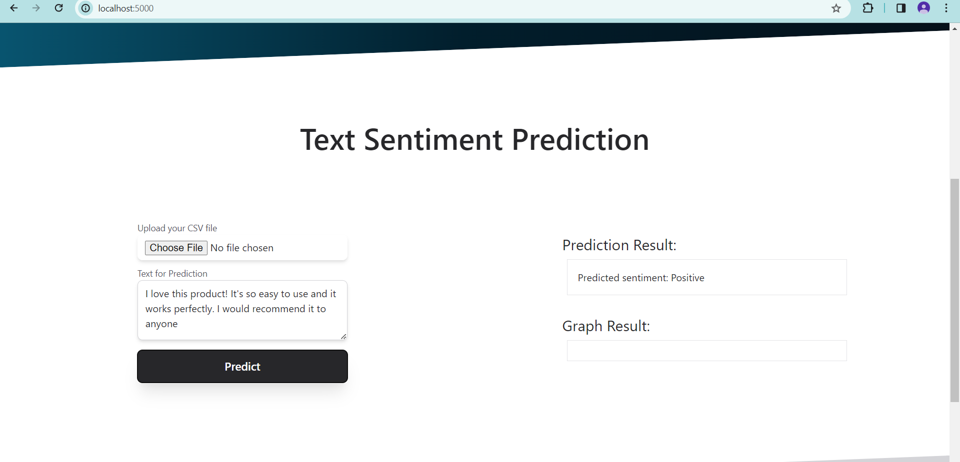
POSITIVE PREDICTION EXAMPLE

Slide 28

NEGATIVE PREDICTION EXAMPLE

Slide 29
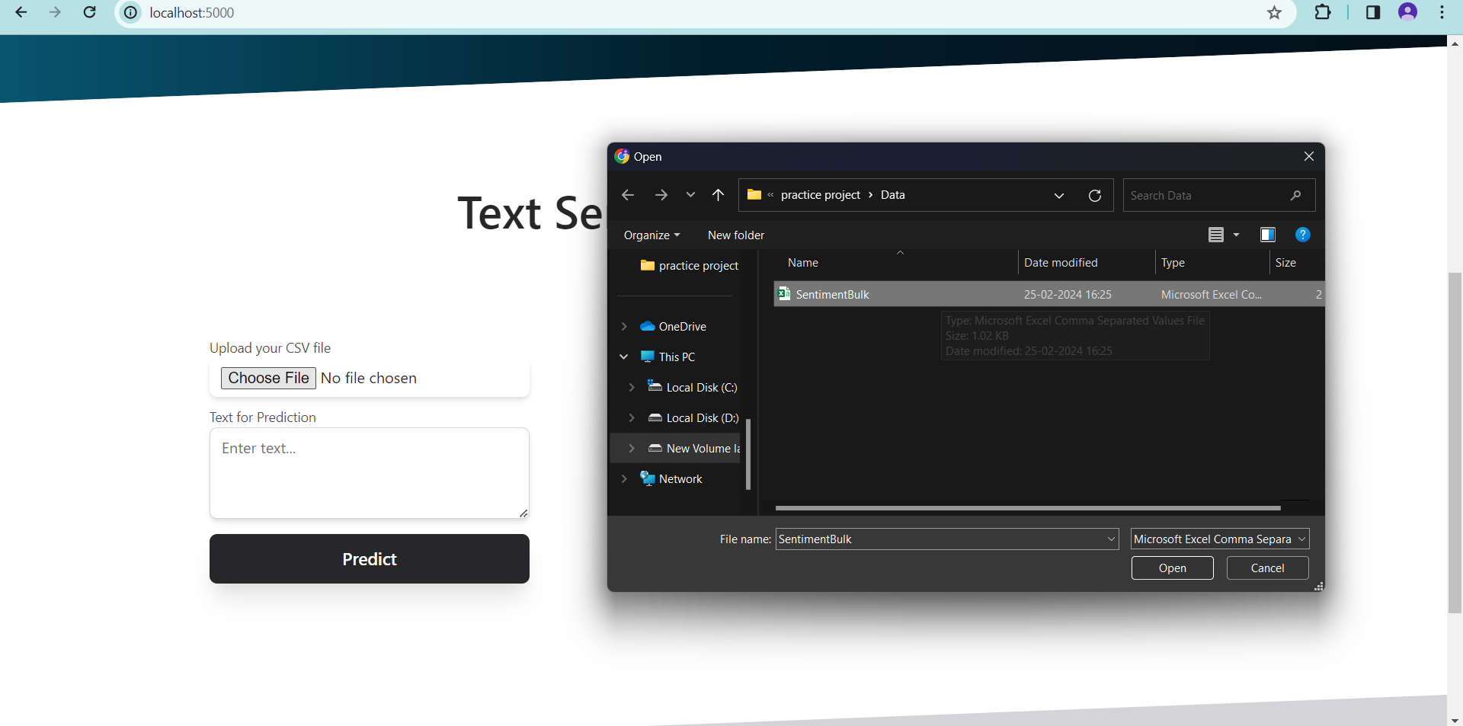
BULK SENTIMENT

Slide 30
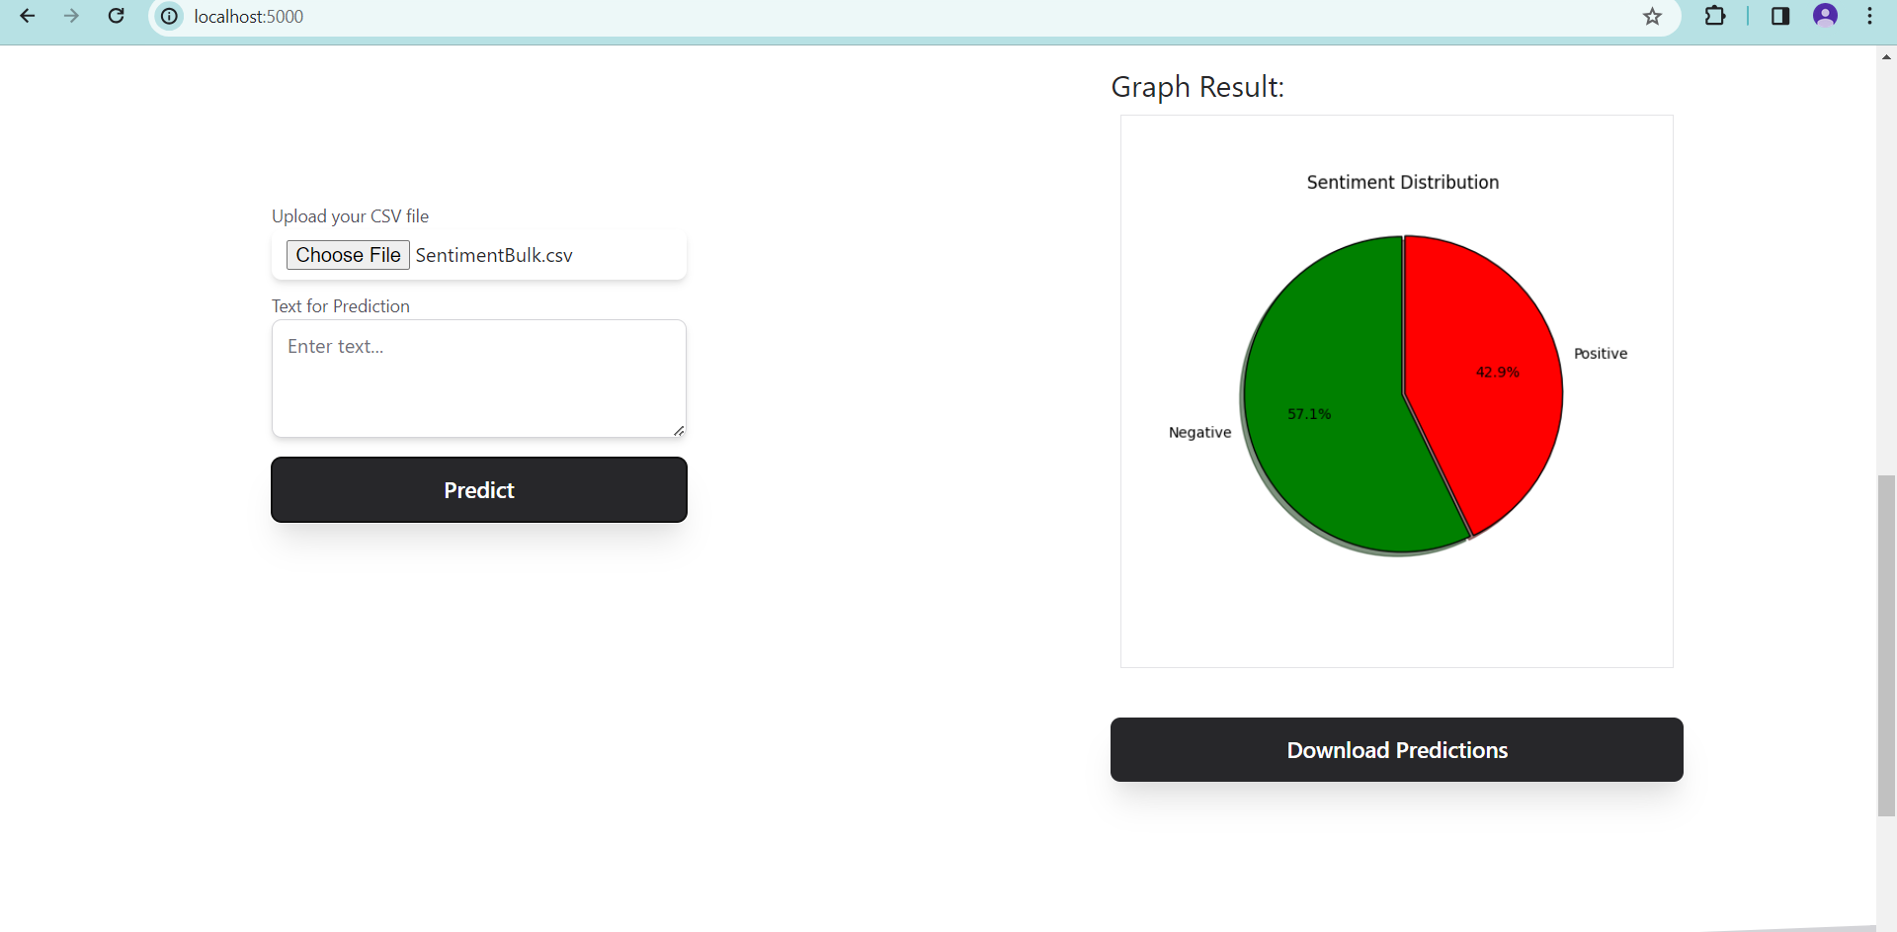
RESULT GENERATION

Slide 31
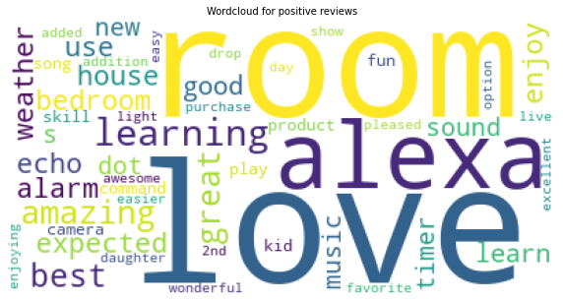
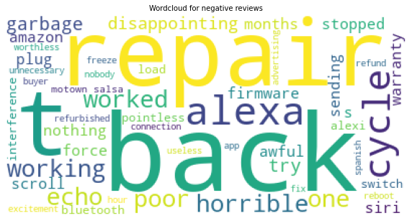
WORD CLOUD FOR POSITIVE REVIEWS
WORD CLOUD FOR NEGATIVE REVIEWS

Slide 32
CONCLUSION
We conclude that the project aimed to improve the sentiment analysis of Amazon Alexa reviews by using machine learning and NLP-based approaches. This allowed for a more adaptive, data-driven, and context-aware approach, overcoming the limitations of a rule-based approach. The interface supports various functionalities, including selecting the dataset for analysis, inputting text for analysis, and displaying the sentiment analysis results.

Slide 33
FUTURE ENHANCEMENT
In the future, it is possible to integrate with more advanced NLP libraries such as spaCy to leverage pre-trained language models for better feature extraction and sentiment analysis and implement real-time sentiment analysis capabilities to analyze sentiments from live Amazon reviews as they are posted, providing timely insights to users. Extend the sentiment analysis to aspect-level sentiment analysis, where sentiments are analyzed for specific aspects or features mentioned in the reviews like product quality and customer service.

Slide 34
REFERENCES
[1] Krishnendu Chakraborty, Machine Learning with Real World Projects. Infosys wingspan.
[2] A. Bandi and A. Fellah, “Socio-analyzer: A sentiment analysis using social media data,”
in Proc. 28th Int. Conf. Softw. Eng. Data Eng., in EPiC Series in Computing, vol. 64, F. Harris, S. Dascalu, S. Sharma, and R. Wu, Eds. Amsterdam, The Netherlands: EasyChair, 2019, pp.
[3] U. Naseem, S. K. Khan, M. Farasat, and F. Ali Abusive language detection:
A comprehensive review. Boca Raton, FL, USA: CRC Press, 2013.

Slide 35
THANK YOU

